Slide 1
C the Programming Language
The Preproceeors

Slide 2
C Preprocessor:
It is a program that processes our source program before it is passed to the compiler.
Preprocessor commands (often known as directives) form what can almost be considered a language within C language.
There are several steps involved from the stage of writing a C program to the stage of getting it executed.

Slide 3
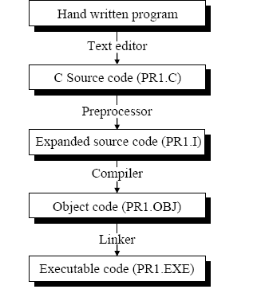

Slide 4
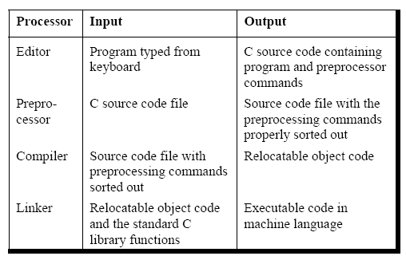

Slide 5
The preprocessor offers several features called preprocessor directives.
preprocessor directives begin with a # symbol.
The directives can be placed anywhere in a program but are most often placed at the beginning of a program, before the first function definition.
Macro expansion
File inclusion
Conditional Compilation
Miscellaneous directives

Slide 6
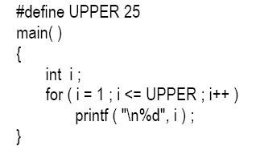
Macro Expansion

Slide 7
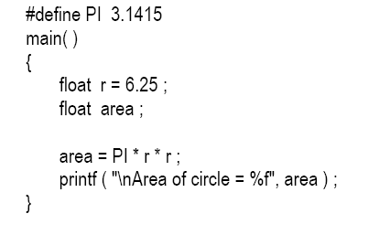
Cont’d:

Slide 8
Cont’d:
Million dollar question... why use #define in the above programs.
For example, if the phrase “\x1B[2J” causes the screen to clear. But which would you find easier to understand in the middle of your program “\x1B[2J” or “CLEARSCREEN”?
#define CLEARSCREEN "\x1B[2J"

Slide 9
Examples:
#define directive is popularly used by C programmers In following cases:

Slide 10
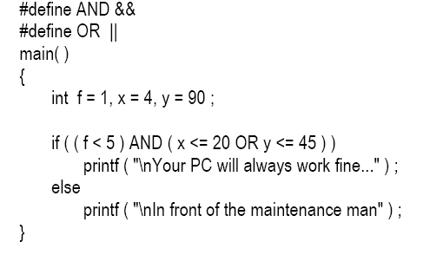

Slide 11

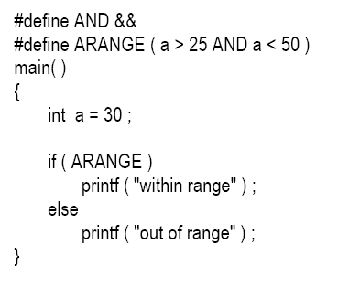

Slide 12
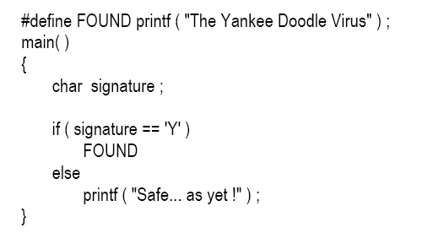

Slide 13
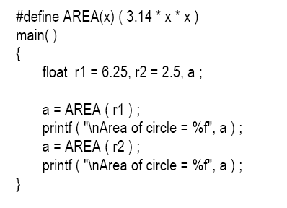
Macros with Arguments :

Slide 14
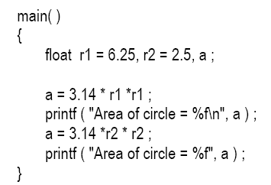

Slide 15
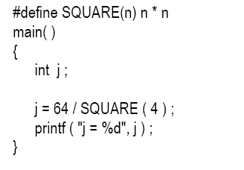
Certain Key points:

Slide 16
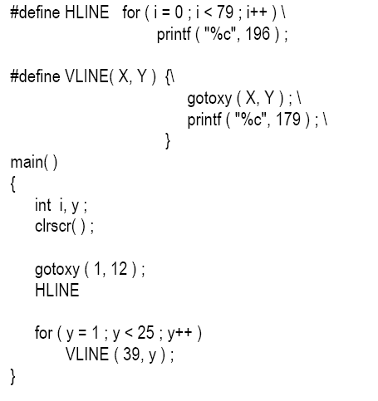

Slide 17
Macros and Functions:

Slide 18
File Inclusion :
This directive causes one file to be included in another.
#include "filename" .
It simply causes the entire contents of filename to be inserted into the source code at that point in the program.

Slide 19
When and why File inclusion is to be used.
If we have a very large program, the code is best divided into several different files, each containing a set of related functions. These files are #included at the beginning of main program file.
Some commonly needed functions and macro definitions can be stored in a file, and that file can be included in every program we write, which would add all the statements in this file to our program as if we have typed them in.

Slide 20
Cont’d:
It is common for the files that are to be included to have a .h extension.
prototypes of all mathematics related functions are stored in the header file ‘math.h’,
prototypes of console input/output functions are stored in the header file ‘conio.h’,

Slide 21
There exist two ways to write #include statement.
#include "filename"
#include <filename>

Slide 22
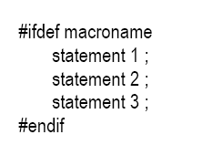
Conditional Compilation:

Slide 23
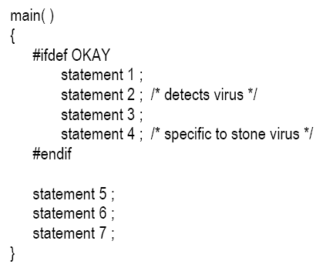
Use of conditional compilation:

Slide 24

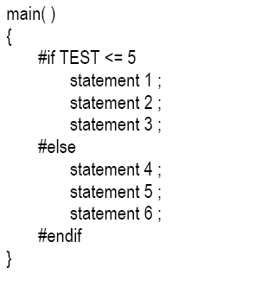

Slide 25
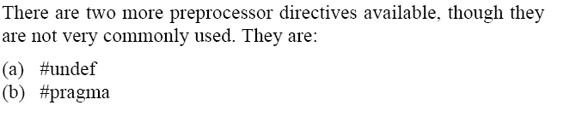
Miscellaneous Directives:

Slide 26

On some occasions it may be desirable to cause a defined name to become ‘undefined’.
This can be accomplished by means of the #undef directive.
#undef macro template

Slide 27
#pragma Directive
This directive is another special-purpose directive that you can use to turn on or off certain features.
#pragma startup and #pragma exit
#pragma warn:

Slide 28
#pragma startup and #pragma exit:
These directives allow us to specify functions that are called upon program startup (before main( )) or program exit (just before the program terminates).

Slide 29
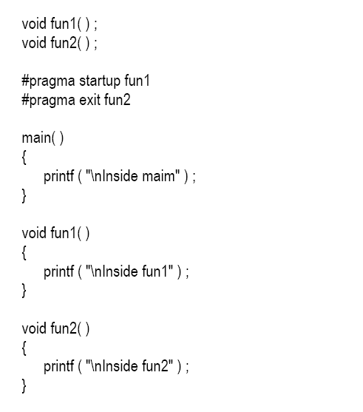


Slide 30
#pragma warn
This directive tells the compiler whether or not we want to suppress a specific warning.

Slide 31
